Slide 1
HL7 Payer Summit More FHIR
David Hay
Sept 19, 2014

Slide 2
This presentation
Can be downloaded here:
http://gforge.hl7.org/svn/fhir/trunk/presentations/2014-09 Tutorials/FHIR for Payers 2.pptx
Use “anonymous” and email address to logon
Is licensed for use under the Creative Commons, specifically:
Creative Commons Attribution 3.0 Unported License
(Do with it as you wish, so long as you give credit)

Slide 3
Who am I?
Name: David Hay
Company: Orion Healthcare
Background:
Trained as MD, been in Health IT 30 years
Co-chair FHIR Management Group
Chair HL7 New Zealand
FHIR Blogger (http://fhirblog.com)

Slide 4
Agenda
Some more FHIR features
Profiles & Extensions
Versions
Paradigms
Deriving clinical information from claims data

Slide 5
Profiles & Extensions
Keeping things simple
The infamous 80%
Machine readable
Registries
“Standard” extensions
Profile
Registry
Resource
Extension
HTTP://server/Profile/nzpatient#iwi
The extension points to its profile
Can be (and probably are) on different servers
Notes:
Claims specific

Slide 6
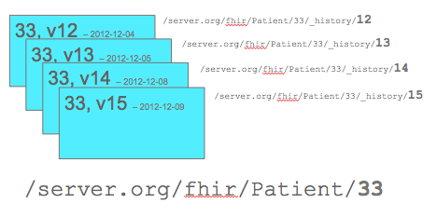
Versions
Resources can change
Need to preserve ‘history’ of change
Able to get:
Most recent version
Get history of change
Specific version

Slide 7

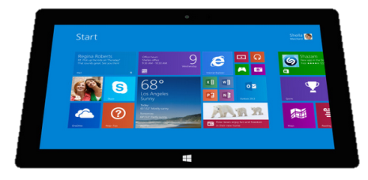
Multiple Paradigms
Receive a lab result in a message…
FHIR
Repository
FHIR Message
FHIR Document
Lab System
REST
National
Exchange
…Package it in a discharge summary document

Slide 8
Deriving Clinical Value
Assuming Aggregation of claims
Provider
Pharmacy
Privacy
Provenance
Audit

Slide 9
Claims related Clinical Information
Membership
PCP history
Problems (Conditions)
Dispensed / Administered Medications
Procedures
Notes:
Reimbursement vs clinical focus

Slide 10
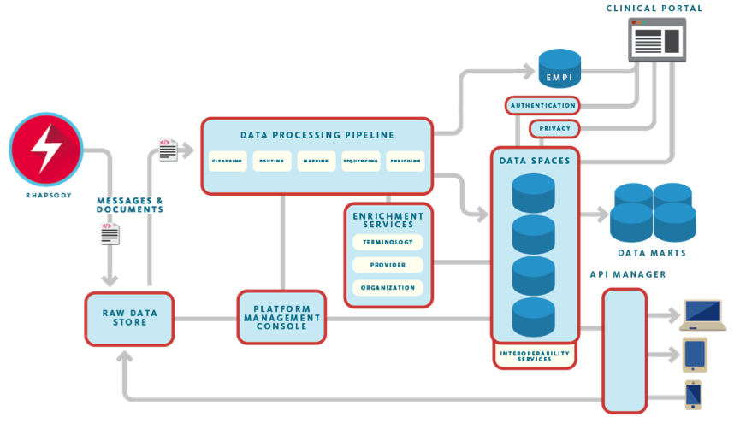

Possible Architecture
Txt
Input
Data

Slide 11
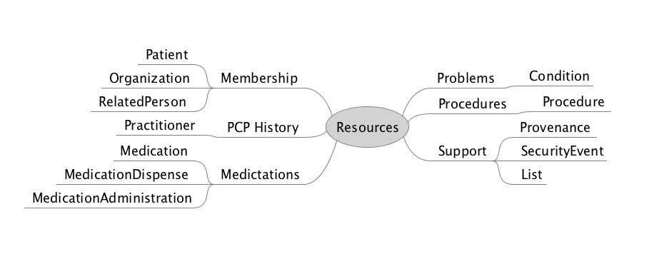
Resources
Notes:
Provanance & secutity

Slide 12
Consuming the data
HIE
EMR systems
Patient Portals
Mobile
Notes:
Provenance again

Slide 13
The Message
Can use claims data to improve patient care – and not just by funding it.

